Slide 1
Counting the Homeless

Slide 2
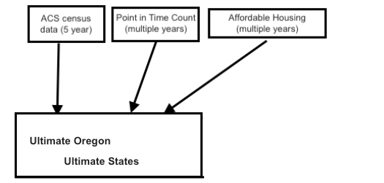
Our Data

Slide 3
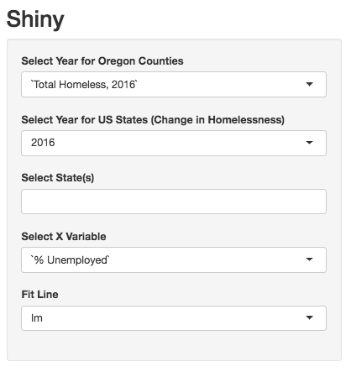
What our Shiny offers

